Slide 1
BMC: What is the Literature Telling Us?
Ronna S. Parsa, D.O.
Orthopedic Surgeon
Fellowship-trained in Sports Medicine
August 16, 2019

Slide 2
DISCLOSURES
•Executive Medical Consultant: ForeverLabs, Inc.
•Educational Consultant: Arthrex, Inc.

Slide 3
Objectives
Overview
Basics
Review of Literature
Nonunions
Cartilage and OA
Meniscectomy
Rotator Cuff
Spine
Complications

Slide 4
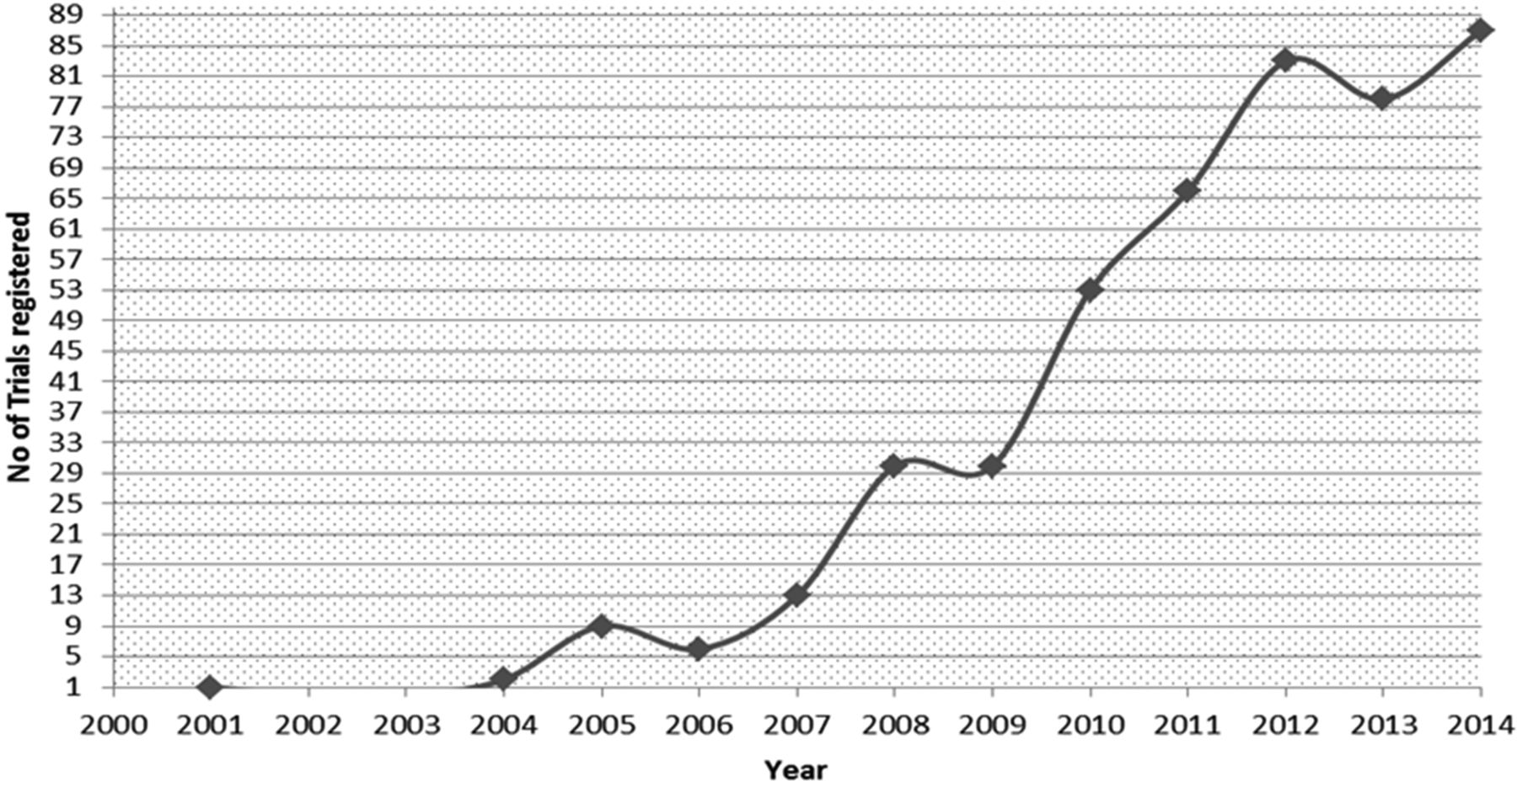
Overview
Stem Cell Market is projected to reach $15.6 Billion by 2025, CAGR 9%
In 2001, Knee OA direct and indirect cost > $65 Billion/yr in US
Number of studies conducted are exponentially increasing
Variety of specialties: Orthopedics, Dermatology, Plastics, Ophthalmology, Cardiology, etc.
Increased Direct to Consumer Advertising without increase in studies showing efficacy

Slide 5
Bone Marrow Aspirate
Contains high levels of endothelial progenitor cells, HSCs, MSCs, Evs, growth factors and anti-inflammatory cytokines
Posterior iliac crest harvest → highest yield
Other sites: ASIS, proximal tibial, distal femur, proximal humerus, calcaneus
Pros → Easy harvest, large cell yield
Cons → Donor site morbidity, expensive

Slide 6
Fracture Healing - Nonunion
Many studies support injecting autologous aspirates into fracture site
Good evidence that autologous MSCs improve fracture healing in setting of nonunion
Correlation between callus formation and # CFUs supports treatment effects (Hernigou et al)

Slide 7
Role of Biologics in Knee Preservation
Prevent Cartilage Damage
Disease Modification
Non-surgical treatment of OA
Adjunct to surgical interventions
Biologics as surgical interventions
Goodrich et al JBJS 2016

Slide 8
Cartilage & Osteochondral Defects
Full Thickness Cartilage Lesions
Evolving Evidence
Gobbi et al 2016 → BMAC better than MFx, maintains results @ 5 yrs
Multiple studies (Enea, Gigante, Gobbi) → clinical improvement when surgical treatment augmented with BMC
Osteochondral Defects
Multiple Studies (Buda, Hannon, Kennedy)→ improved outcomes with BMC augmentation of Mfx, OCA and ACI

Slide 9
Knee Osteoarthritis: Dose Response
Control vs. Low Dose vs. High Dose BMSC (> 4 x 10⁸)
BMC injections improve knee function and pain in OA patients
Both doses improved, but higher concentration sig (1.6 vs. 3.2, P <0.001)
Dose may be important factor in clinical outcome results
Notes:
Sensitivity and specificity for composite pain and function improvement as predicted by nucleated cell count

Slide 10
Knee Osteoarthritis
Level II, RCT
25 patients w/ bilateral knee pain and OA
BMAC + PPP vs. Saline
BMAC is safe and a reliable & viable cellular product
No significant difference bw BMC and placebo after 6 months

Slide 11
Systematic Reviews
All 3 studies regarding OA and 3 studies regarding focal chondral defects reported good to excellent overall outcomes with use of BMC
420 papers screened→ 4 Level II and 2 Level III: Overall quality of literature was poor, methodology was fair
Level III and IV evidence, all tx were in addition to surgery, HA or PRP
“All studies were found to be at high risk of bias. Therefore, we do not recommend use of stem cell therapy for patients with KOA”

Slide 12
Subchondral Therapy
BMC Iliac crest harvest
40cc injection subchondral
Average 6500 MSC/cc
Notes:
Same knee 10 years post op

Slide 13
Meniscectomy
55 patients partial medial meniscectomy
Double-blinded RCT
Single injection 7-10 days post-op
Randomized into 3 groups
Group A: 50 x 10⁶ allogenic MSCs
Group B: 150 x 10⁶ allogenic MSCs
Control: Sodium hyaluronate
Evidence of Meniscal Regeneration
Improved knee pain (VAS & Lysholm)
Notes:
Preparation of ex vivo cultured adult human MSC derived from BMA obtained from unrelated donors not HLA matched to recipients . Donors were 18-30yo and screened and tested according to FDA requirements for blood and tissue based product
Regeneration based on MRI > 15% increase in meniscal volume
Improvement in VAS pain scores through two years post meniscectomy surgery in patients with evidence of cartilage degeneration on MRI. The time points at which strong trends or significant differences from the control were observed were at two years for Group A (p = 0.05), and at one year (p = 0.08) and two years (p = 0.04) for Group B. Control = sodium hyaluronate, Group A = 50 x 10⁶ hMSCs, and Group B = 150 x 10⁶ hMSCs. The I bars represent 95% confidence intervals.

Slide 14
Treatment of Partial Rotator Cuff Tears
24 pts: BMAC-PRP injection vs 3 months of PT
No difference In at 3 weeks, but sig at 3 months
Improved VAS pain and ASES shoulder function scores

Slide 15
Rotator Cuff Repair
BMAC during RCR may enhance healing rates, improve radiographic quality of repair surface, and decrease risk of re-rupture compared to controls

Slide 16
Spine and Clinical Trials
4 published clinical reports
EuroDisc
Significantly less back pain and increased NP T2 signal MRI at 2 years
Case report of 2 patients (autologous MSCs)
Pilot study 10 patients w/ autologous MSCs w/ good results
Pilot study 10 patients w/ HSCs w/ poor results
Notes:
Human literature limited, outcomes mainly based on pain

Slide 17
Disc Disease and BMC injections
Notes:
Level 3 and 4 studies
Eurodisc trials
Positive outcomes were pain
Stem cells have known antiinflam porperties

Slide 18
Dosing in Spine Literature
Most published studies have administered bw 10⁶ - 10⁷ cells/disc
MSCs exhibit an inherently anti-inflammatory effect and current successes with respect to back pain may be dose-related and not represent true structural changes
The ultimate fate these cells is unclear
Injecting metabolically active cells in high number to a low oxygen and low nutrient environment is problematic
Trophic effects on native cells unknown

Slide 19
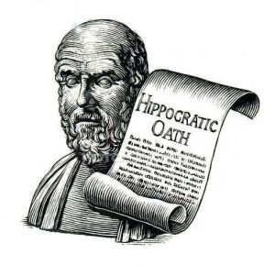
Potential Complications
Centeno et al 2016 → A Multi-center Analysis, adverse events of 2372 adult patients after adult autologous stem cell therapy for orthopedic conditions
325 adverse events (mostly injection related pain or progressive OA
7 neoplasms (lower rate than general population)
Berkowitz et al 2016 → Glioproliferative Lesion of the Spinal Cord as a Complication of “Stem-Cell Tourism”
Case reported after intra-thecal embryonic stem cell infusion after stroke
Developed spinal tumor with ”non-host” cells

Slide 20
Summary
Technologies behind orthobiologics continue to evolve faster than we can keep up with
Good evidence for MSC tx of appendicular skeletal nonunion
Established tx effect of MSCs on meniscectomy, knee OA, and knee/ankle chondral defects
Differences in preparations, concentration, combination of txs
Dose related response noted
No all orthopedics conditions are created the same

Slide 21
Thank you

Slide 22
References
Buda R, Vannini F, Castagnini F, et al. Regenerative treatment in osteochondral lesions of the talus: autologous chondrocyte implantation versus one-step bone marrow derived cells transplantation. International orthopaedics. 2015;39(5):893-900.
Enea D, Cecconi S, Calcagno S, Busilacchi A, Manzotti S, Gigante A. One-step cartilage repair in the knee: collagen-covered microfracture and autologous bone marrow concentrate. A pilot study. The Knee. 2015;22(1):30-35.
Enea D, Cecconi S, Calcagno S, et al. Single-stage cartilage repair in the knee with microfracture covered with a resorbable polymer-based matrix and autologous bone marrow concentrate. The Knee. 2013;20(6):562-569.
Gigante A, Calcagno S, Cecconi S, Ramazzotti D, Manzotti S, Enea D. Use of collagen scaffold and autologous bone marrow concentrate as a one-step cartilage repair in the knee: histological results of second-look biopsies at 1 year follow-up. International journal of immunopathology and pharmacology. 2011;24(1 Suppl 2):69-72.
Gobbi A, Chaurasia S, Karnatzikos G, Nakamura N. Matrix-Induced Autologous Chondrocyte Implantation versus Multipotent Stem Cells for the Treatment of Large Patellofemoral Chondral Lesions: A Nonrandomized Prospective Trial. Cartilage. 2015;6(2):82-97.
Gobbi A, Karnatzikos G, Sankineani SR. One-step surgery with multipotent stem cells for the treatment of large full-thickness chondral defects of the knee. The American journal of sports medicine. 2014;42(3):648-657.
Gobbi A, Karnatzikos G, Scotti C, Mahajan V, Mazzucco L, Grigolo B. One-Step Cartilage Repair with Bone Marrow Aspirate Concentrated Cells and Collagen Matrix in Full-Thickness Knee Cartilage Lesions: Results at 2-Year Follow-up. Cartilage. 2011;2(3):286-299.
Hannon CP, Ross KA, Murawski CD, et al. Arthroscopic Bone Marrow Stimulation and Concentrated Bone Marrow Aspirate for Osteochondral Lesions of the Talus: A Case-Control Study of Functional and Magnetic Resonance Observation of Cartilage Repair Tissue Outcomes. Arthroscopy : the journal of arthroscopic & related surgery : official publication of the Arthroscopy Association of North America and the International Arthroscopy Association. 2016;32(2):339-347.
Hernigou P, Flouzat Lachaniette CH, Delambre J, et al. Biologic augmentation of rotator cuff repair with mesenchymal stem cells during arthroscopy improves healing and prevents further tears: a case-controlled study. International orthopaedics. 2014;38(9):1811-1818.
Kennedy JG, Murawski CD. The Treatment of Osteochondral Lesions of the Talus with Autologous Osteochondral Transplantation and Bone Marrow Aspirate Concentrate: Surgical Technique. Cartilage. 2011;2(4):327-336.
Krych AJ, Nawabi DH, Farshad-Amacker NA, et al. Bone Marrow Concentrate Improves Early Cartilage Phase Maturation of a Scaffold Plug in the Knee: A Comparative Magnetic Resonance Imaging Analysis to Platelet-Rich Plasma and Control. The American journal of sports medicine. 2016;44(1):91- 98.
Shapiro SA, Kazmerchak SE, Heckman MG, Zubair AC, O'Connor MI. A Prospective, Single- Blind, Placebo-Controlled Trial of Bone Marrow Aspirate Concentrate for Knee Osteoarthritis. The American journal of sports medicine. 2017;45(1):82-90.

