Slide 1
Regulatory Overview of Biologic Therapies
Ronna S. Parsa, D.O.
Orthopedic Surgeon
Fellowship-trained in Sports Medicine
August 16, 2019

Slide 2
Disclosures
Executive Medical Consultant: ForeverLabs, Inc.
Educational Consultant: Arthrex, Inc.

Slide 3
Objectives
Background
Definitions
Policies and Guidance
Future Focus

Slide 4
Background
Tiered, risk-based approach, “Tissue Rules”
Focused on Public Health and Regulatory concerns:
  Prevent transmission of communicable disease
  Processing controls to prevent contamination resulting in unsafe and ineffective products
  Preserve integrity and function, products work as intended
  Assure clinical safety and efficacy

Slide 5
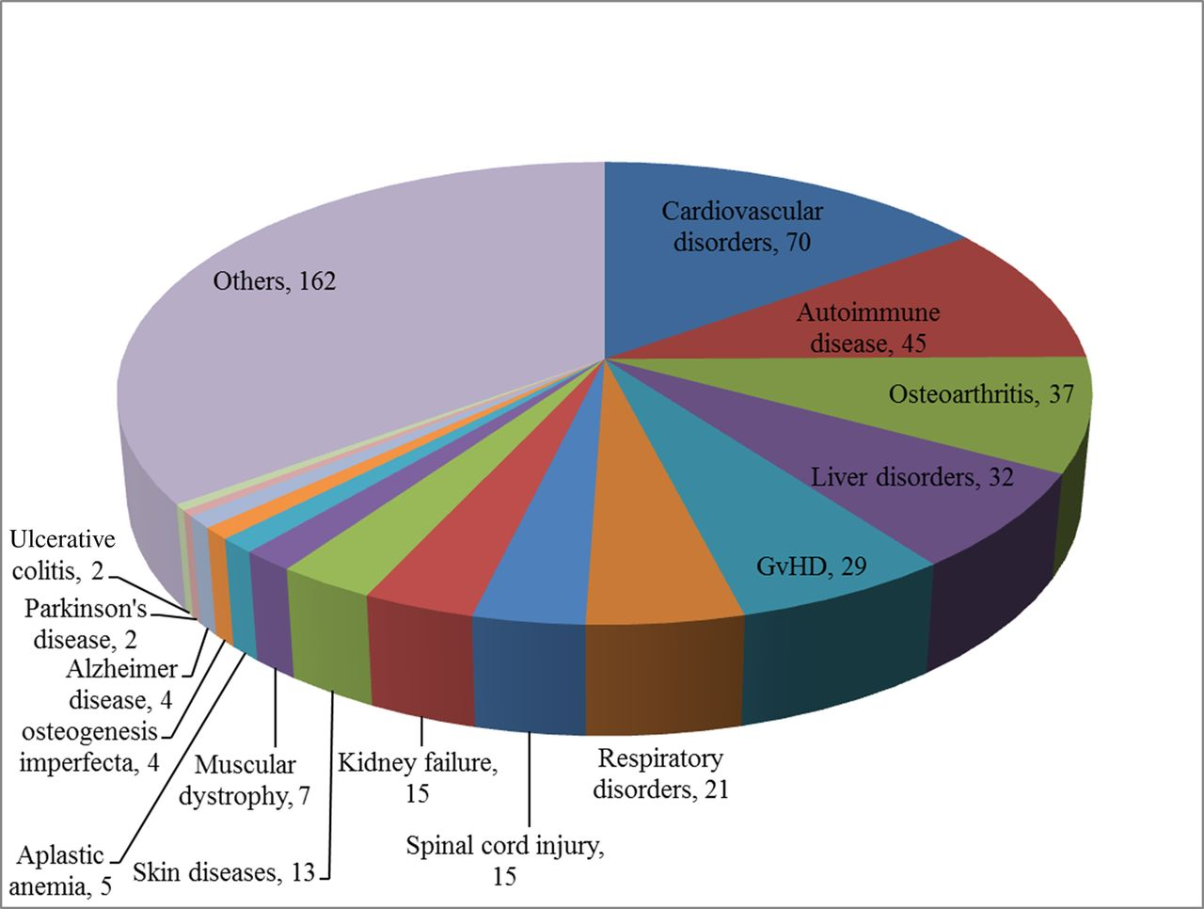
MSCs Based Trials
Notes:
Number of common diseases registered for MSCs based cell therapy trials
Though adult-derived hMSCs are a favorite choice, but before hMSCs can be used on large-scale clinical applications for cell therapy, there is a need for completely understanding the underlying mechanisms that regulate and modulate these MSCs

Slide 6
Risk Assessment of Stem Cells
Fink DW 2009
Notes:
Risk assessment of stem cell–based products. The potential for tumor formation (tumorigenicity) represents a concern correlated with the self-renewal of undifferentiated cells, whereas cells at other levels of maturation may also pose risk. Many stem cell–based therapies will not consist of a pure, homogeneous target cell population, which raises additional questions about risks that nontarget cells may present, as well as their physiologic role after administration. Ectopic tissue formation and migration from the site of transplantation are also concerns, particularly when stem cell–based products are introduced to anatomically sensitive sites. Additionally, differentiation of stem cell–based products that are allogeneic with respect to the recipient results in increased immunologic incompatibility due to expression of foreign nonself antigens. Death of large proportions of the transplanted cell population, not unique to stem cells, may constitute further risk.

Slide 7
Definitions
Drugs:
  Articles to Prevent, Cure or treat disease
  Primary purpose through chemical action/metabolization
  Articles Intended to Affect Structure or Function of the Body: Section 201(h)
Devices:
  Same Definition as drug, except no chemical or metabolic action
  Primary purpose by ”Mechanical” means
Biologics: (Section 351, PHS Act)
  A virus, serum, toxin, antitoxin, vaccine, blood, blood component or derivative, allergenic, or analogous product
  Same Definition as drug, but through biologic process and not chemical
  Recombinant technology, isolated from natural sources

Slide 8
Definitions
  HCT/Ps: Human Cells, Tissues, and Cellular and Tissue-Based Products
    21 CFR 1271.3(d): Intended for implantation, transplantation, infusion, or transfer into human recipient
      From deceased donor
      From living donor
      CBER does not regulate vascularized human organ transplant

Slide 9
HCT/P
Differentiating Principles:
Minimal Manipulation
Homologous Use Only
Non-Combination
Non-Systemic Effect or if Systemic dependent:
  Autologous Use
  Allogenic in 1st or 2nd degree relative
  Reproductive use

Slide 10
Definitions
Minimal Manipulation:
  For structural tissue, processing doesn’t alter original characteristics of tissue for reconstructions, repair or replacement
  For cells (nonstructural), no alteration of relevant biological characteristics of cells or tissue

Slide 11
Minimal Manipulation
Weber DJ BioPro 2004

Slide 12
Homologous Use
Repair, Reconstruction, Replacement, or supplementation of a recipient’s cells or tissue with HCT/P that performs the same basic function in recipient as in donor

Slide 13
Homologous Use
Weber DJ BioPro 2004

Slide 14
HCT/Ps
Section “361”
Low Risk
Section “351”
High Risk
No pre-clinical animal or phased clinical trails prior to human treatment
Less stringent process & manufacturing requirements
Premarket review and approval not required
Pre-clinical animal or phased clinical trails prior to human treatment
Stringent process & manufacturing requirements
Strong regulatory oversight

Slide 16
Regulation Summary
Bone Marrow Aspirate
  Point of Care
  Optimize Harvest
Autologous Adipose Treatments
  FDA Approved Devices
  FDA Guidance and Warning Letters —> Consider processing more that minimal manipulation
Intra-articular Harvest
  Further Development

Slide 17


Slide 18
Future Focus
Cultured Cells
Amniotic Cells
Peripherally Mobilized Cells

Slide 19
Thank you

Slide 20
References
Fink DW. FDA Regulation of Stem Cell- Based Products. Science 2009. 324(5935), 1662-1663. DOI: 10.1126/science.1173712
Weber DJ. Navigating FDA Regulations for Human Cells and Tissue. BioProcess Int. SEP 2004
https://www.fda.gov/vaccines-blood-biologics/cellular-gene-therapy-products/framework-regulation-regenerative-medicine-products

